Slide 1
Geogg124 Terrestrial Ecosystem Modelling
P. Lewis
Professor of Remote Sensing
UCL Geography
& NERC NCEO

Slide 2
Aims of lecture
In this lecture, we will consider:
Land surface schemes
Global vegetation modelling
Production efficiency models
Phenology
Modelling Photosynthesis

Slide 3
1. Land surface schemes
LS schemes, implemented as LS models
LS component of climate / earth system models
Purpose:
Model energy and (carbon, water) fluxes at land-atmosphere interface

Slide 4
Main driver: energy
Rn=S↓(1−α)+L↓−L↑
Rn = net radiation; S↓ = downwelling s/wave; α = albedo; L↓, L↑ down/upwelling longwave
terms balance globally over the long term
But short term /spatial variations drive earth system

Slide 5
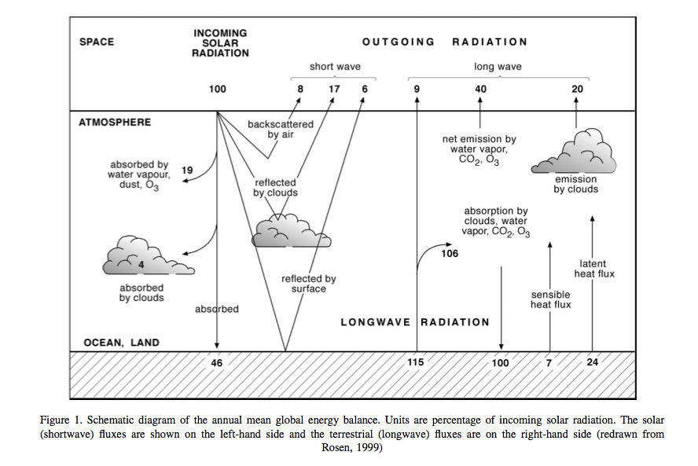
Notes:
In the above figure, showing global averages of components of the energy balance, the solar radiation is represented as 100 units. Around 31 units are exchanged as sensible and latent heat fluxes (H and λE respectively), but the properties of the land surface significantly affect the way these fluxes are partitioned. The land surface also acts to store energy on various timescales (diurnal, seasonal, and longer).

Slide 6
Balance by heat & chemical fluxes
Rn=H+λE+G+F
H = sensible heat flux; λE = latent heat flux; G = soil flux; F = chemical energy flux stored in photosynthesis
Latent heat – heat absorbed/released by change of state at constant T (eg liquid to vapour)
Sensible heat – causes solely change in T
Notes:
The net radiation Rn must be balanced by H and λE and by the soil flux G and the chemical energy flux F stored in photosynthesis:

Slide 7
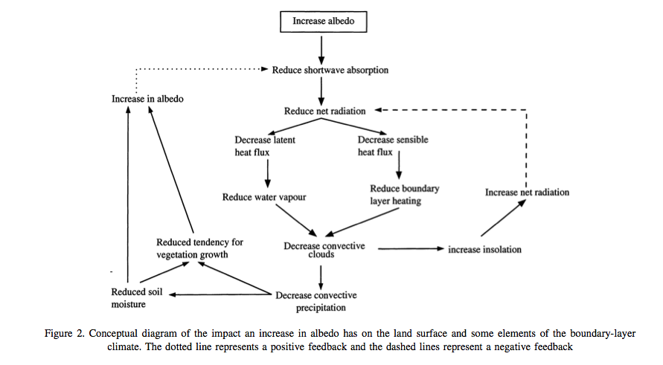
Notes:
We can already see from these equations that changes in e.g. albedo α are likely to alter H and λE by altering Rn.

Slide 8

Changing albedo

Slide 9
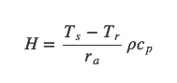
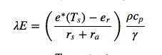
Partitioning latent & sensible heat
Partitioning important as controls flux of water vapour to the atmosphere
Influence on cloudiness, rain
H and λE are turbulent heat fluxes
T_{s} = surface T; T_{r} = ref. temp. above surface; r_{a} = aerodynamic resistance; ρ = density of air; c.r = specific heat of air. e*(Ts) is saturated vapour pressure at Ts; e_{r} = vapour pressure at ref height; v = psychometric constant; r_{s} = bulk surface resistance to transfer of water to air.
Notes:
where Ts is the surface temperature, Tr is a reference temperature above the surface, ra is the aerodynamic resistance , ρ is the density of air, and cp is the specific heat of air.
where e∗(Ts) is the saturated vapour pressure at Ts, er is the vapour pressure at a reference height, γ is the psychrometric constant and rs is the bulk surface resistance to the transfer of water from the surface to the air.

Slide 10
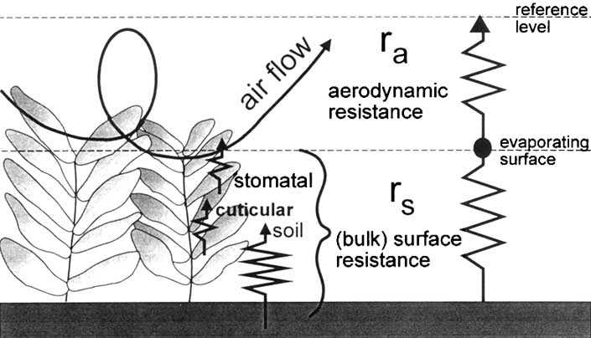
surface and aerodynamic resistances for water vapour flow

Slide 11
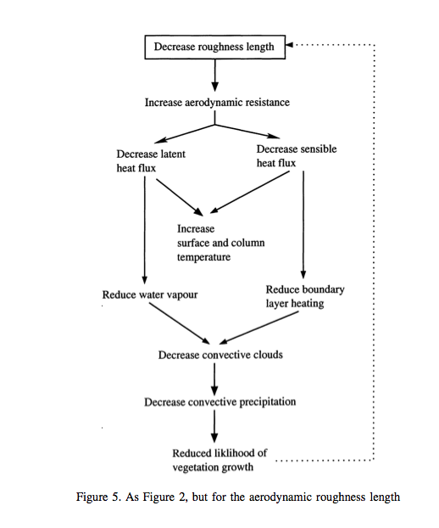
Roughness length depends on vegetation height
Removal of vegetation can have feedback effect

Slide 12
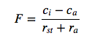
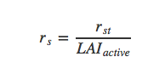
Other fluxes
Turbulence also affects other fluxes e.g. CO2
So we can relate internal and ambient CO2 to stomatal and aerodynamic resistance
Approx.
Notes:
where F is the the CO2 flux density (kgm−2s−1), ci is the internal leaf CO2 concentration, and ca is the ambient CO2 concentration. Here, rst is the stomatal resistance (see below), a measure of the difficulty (or ease) for the vegetation to transpire.
The stomatal resistance is not the same as the bulk surface resistance rs above as rs includes the resistance to moisture transfer from the soil and leaf surface. For a crop or grassland, the bulk surface resistance can be estimated as rs = rst / LAI_active where LAIactive is the active (sunlit) leaf area index, and rst is the ‘bulk’ stomatal resistance of a well-illuminated leaf. Note that this approximation does not include evaporative fluxes from the leaf surface or soil however: in land surface schemes this is usually treated more carefully and involves explicit calculation of the individual resistance terms that combine to make the bulk surface resistance.

Slide 13
Water balance
P=E−Rdrain−Rsurf−ΔS
So we can relate evapotranspiration to runoff, change in soil water storage and water inputs (precip., snowmelt)
P = water input; E = evapotransp.; Rdrain = slow drainage; Rsurf = surface runoff; ΔS = change in soil moisture storage
Notes:
where P is water input to the system (precipitation and snow melt generally, but also translocation of water e.g. in irrigation), E is evapotranspiration (water from the surface to the atmosphere through evaporation from the soil and leaf surfaces and transpiration from leaves), Rdrain is a slow drainage component of water loss from an area, Rsurf is surface runoff, and ΔS is the change in soil moisture storage.

Slide 14
Land Surface Model
Models energy and water fluxes (++) at the land surface
provides an interface of these to atmospheric modelling.
Usually, this will be done for a set of grid cells, where inputs and outputs of each cell are considered separately
Lateral transport of water (e.g. snow, river)

Slide 15
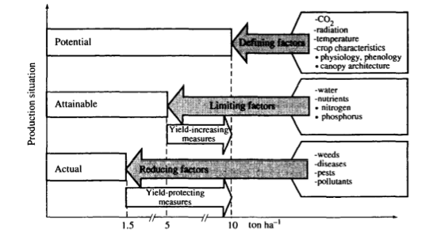
Basic vegetation growth
Notes:
A set of defining factors (plant type, CO2, radiation, etc.) describe how the vegetation would grow under conditions where it is not limited by water and nutrient constraint. It will of course respond to variations in the environmental conditions (CO2, radiation, temperature). This provides a model of the potential growth of the vegetation under these conditions. The attainable growth then is the potential growth modulated by some limiting factors such as water or nutrient availabiliy. The actual growth then has some further modulation by pest, disease etc. or when considering carbon stocks perhaps other reducing factors such as grazing.

Slide 16
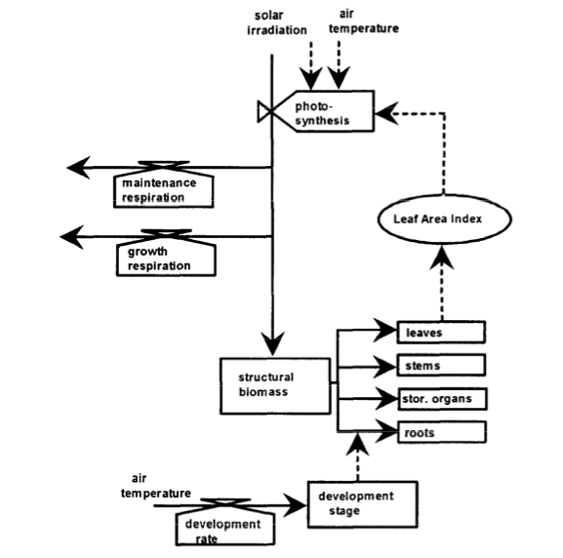
Structure of most models similar
Notes:
The main state variable here is the pool of structural biomass, which is also represented as a set of pools in different plant organs (leaves, stems, roots and storage organs). The fundamental process within such a model then is the production of this pool of stuctural biomass and its allocation to organ pools. The other state variable here is the development stage which strongly affects the allocation rate from the ‘structural biomass’ pool to the different organs. It also impacts plant structure although this is not generally explicitly considered in such models.
The biogeochemical processes represented here are photosynthesis, respiration (maintenance and growth) and the development rate which controls the ‘stage of development’ of the crop. Note that only states and processes directly involving the plant are considered in such a crop growth model (i.e. we do not consider what happens to/in the soil).

Slide 17
Some land surface schemes: Third generation LSMs
1990s+
Advance LSM by connecting leaf stomatal conductance and carbon assimilation
Farquhar et al. (1980) and Farquhar and von Caemmerer (1982)
Can dynamically model vegetation
Examine climate feedbacks

Slide 18
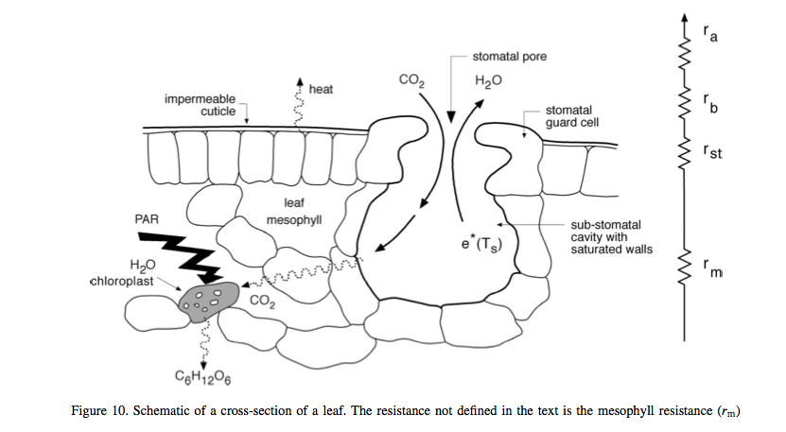
Notes:
essentials of the method are some semi-mechanistic model of stomatal conductance from the net leaf assimilation rate An and the calculation of A_n a as the minimum of potential assimilation under different limitations with leaf respiration subtracted (deal with in detail below)

Slide 19
1. Land surface schemes
Summary
outlined the main processes in land surface schemes and models and highlighted the interplay of radiation and water.
introduced some core concepts in vegetation processes
vegetation growth can be modelled as a potential amount of carbon assimilation that is then limited by factors such as water and nutrient availability as well as being reduced by pests, disease etc.
Looked at some features of 3rd generation LSMs
Include carbon

Slide 20
2. Global vegetation modelling
Focus on linking measurements from Earth Observation and other sources with models of terrestrial carbon at regional and global scales.
motivation for models
to express current understanding of the controls on carbon dynamics as embedded in Earth System / Terrestrial Ecosystem models.
The role of observations is to test and constrain these models to enable:
(i) monitoring of terrestrial carbon dynamics;
(ii) improved prognostic models.
The main focus of the modelling and monitoring is on Net Primary Productivity (NPP).

Slide 21
Types of models
TEMs
Static vegetation representation
DGVMs
Dynamic vegetation
PEMs
Simplifications for ‘data driven’ model

Slide 22
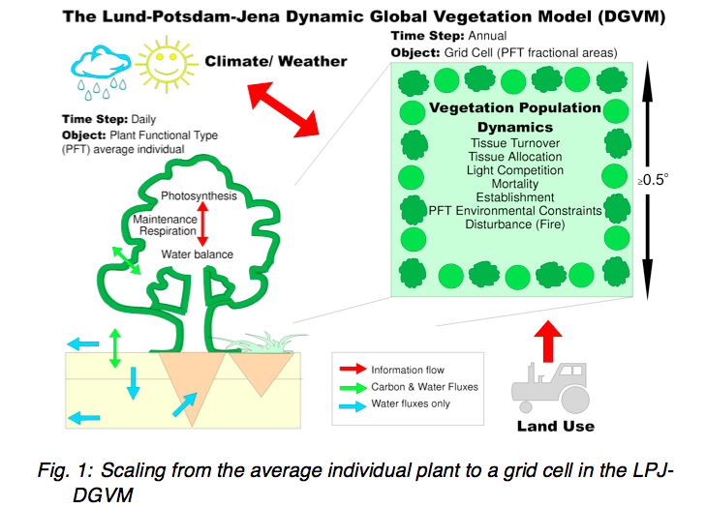
Dynamic Global Vegetation Models

Slide 23
DGVMs
Main components:
establishment,
productivity and competition for resources,
resource allocation,
growth,
disturbance and mortality

Slide 24
DGVMs
Key features:
allows for prognostic and paleo use
geared towards modelling potential vegetation
anthropogenic influences e.g. changes in land use incorporated by forcing these effects
e.g. prescribing land cover/PFT

Slide 25
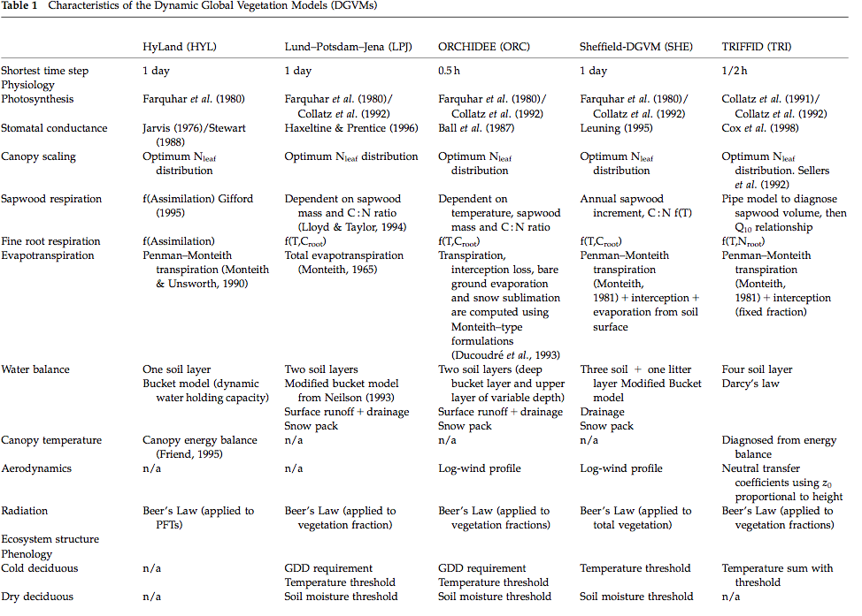
Notes:
Just mention the diff models & go through some of the processes they include, mentioning where they are different … eg beers law etc

Slide 26
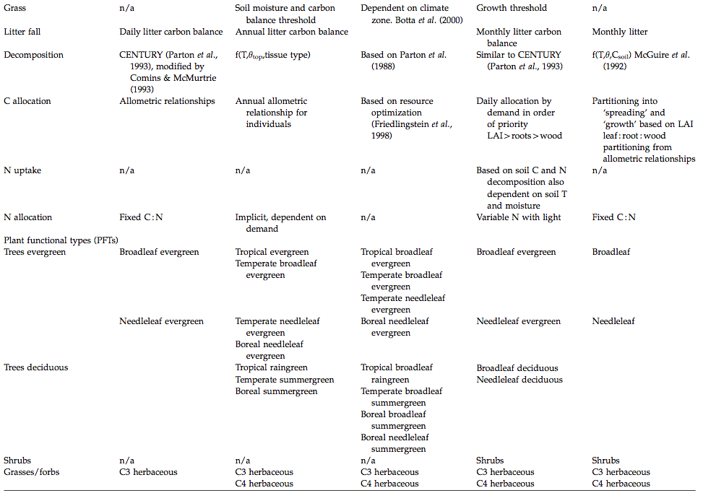
Notes:
Just mention the diff models & go through some of the processes they include, mentioning where they are different
eg few have N uptake models, different ways they have of partitioning the C

Slide 27
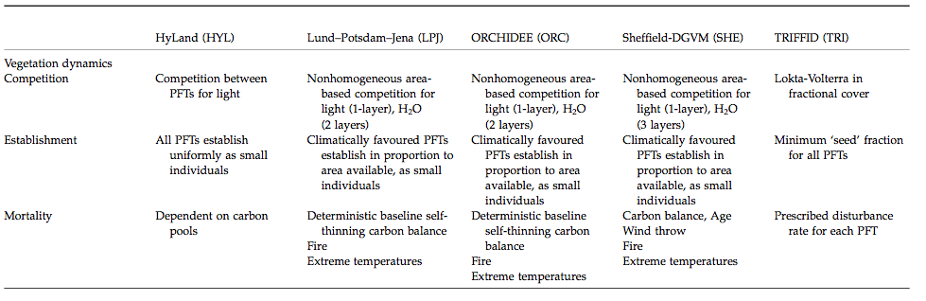
Dynamics, Establishment & Mortality
Notes:
Again, difft approaches applied

Slide 28
Plant Functional Types
Key simplification in DGVMs: PFTs
Group plant types by responses to resources and climate
Simplification allows global modelling
Limits number of parameters required
PFTs should:
represent the world’s most important plant types;
characterize them through their functional behavior;
provide complete, geographically representative coverage of the world’s land areas

Slide 29
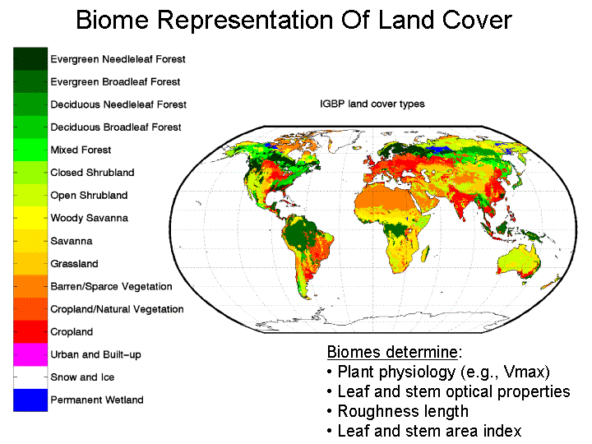
Notes:
Could try to group by biome, but what are the physiological parameters of complex systems such as savannas? So biome forms one basis for PFTs

Slide 30

Box et al. PFTs
Notes:
Box (1996) suggests the following requirements for PFTs. They should:
represent the world’s most important plant types;
characterize them through their functional behavior;
and provide complete, geographically representative coverage of the world’s land areas

Slide 31
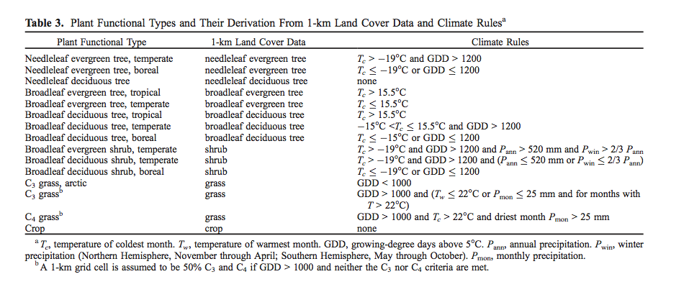
Or Bonan et al., biome/climate rules

Slide 32
PFTs
Some issues:
Uncertainty from land cover
Variations in mappings to PFTs
Assume parameters describing functioning constant over PFT
New evidence from traits databases

Slide 33
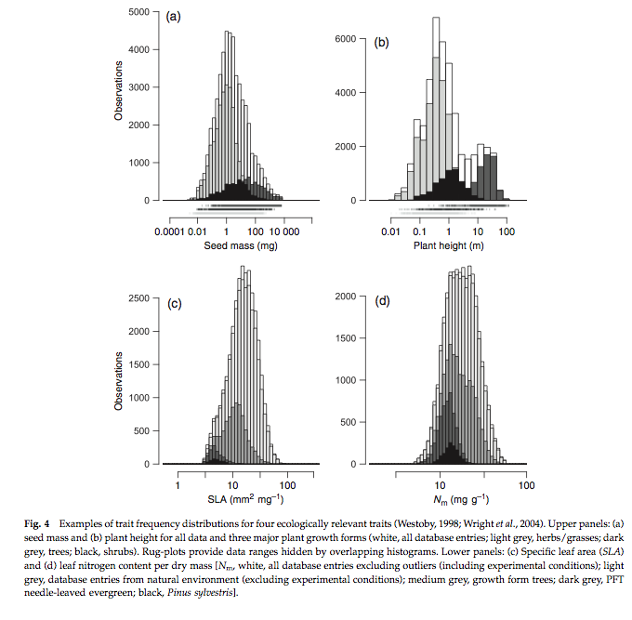
Notes:
Specific leaf area (SLA) and other terms from TRY traits database: Now have distributions of these traits over large number of samples

Slide 34
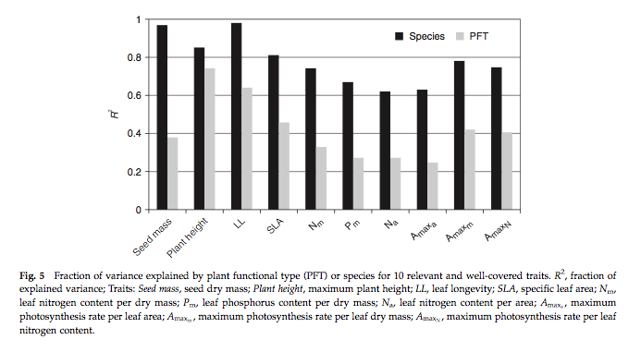
Analysis of species/PFT in TRY
http://try-db.org/pmwiki/index.php
Kattge et al. (2011) GCB
Notes:
here, we can see that for example for specific leaf area (SLA, one-sided leaf area per leaf dry mass) about 40% of the variation in SLA that exists in the database occurs between PFTs, also the variation in the mean between PFTs is similar to the within PFT variation for this trait.

Slide 35
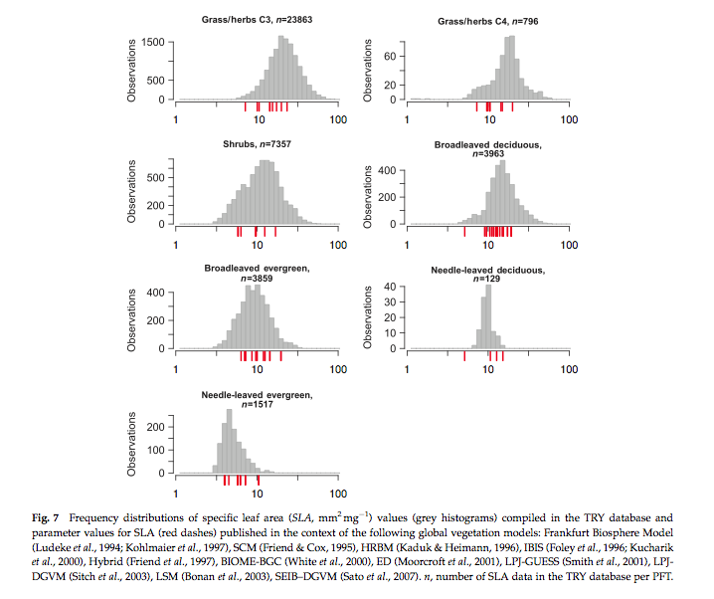
Notes:
The figure above shows frequency distributions of SLA for different PFTs. For some (e.g. needle leaf deciduous) the distribution is quite narrow (but a relative small sample number here) but for most, it is wide. Interestingly, the figure also shows the values of SLA used in different global vegetation models (in red) showing the very wide range of values assumed across different models.

Slide 36
How ‘good’ are these models?
Current benchmarking efforts
International Land Model Benchmarking – iLAMB
Previous (more limited)
Carbon-Land Model Intercomparison Project - C-LAMP
2 models (CASA’, CN)
global carbon sinks for the 1990s differed by a factor of 2
magnitude of net carbon uptake during the growing season in temperate and boreal forest ecosystems was under-estimated

Slide 37
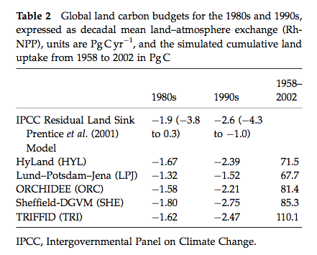
How ‘good’ are these models?
Model intercomparisons (e.g. Sitch et al., 2008)

Slide 38
How ‘good’ are these models?
models estimates within range of current knowledge of C budgets and relatively close to the mean IPCC values.
The models in general agreement about the cumulative land uptake over the last 50 years.
Models simulated the correct sign of response to ENSO events but differed markedly in magnitude.
have similar response of productivity to elevated atmospheric CO2 in agreement with field observations
The DGVMs are in less agreement in the way they respond to changing climate.
suggest a release of land carbon in response to climate
implying a significant positive climate-carbon cycle feedback in each case. This response is mainly due to a reduction in NPP and a decrease in soil residence time in the tropics and extra-tropics, respectively.

Slide 39
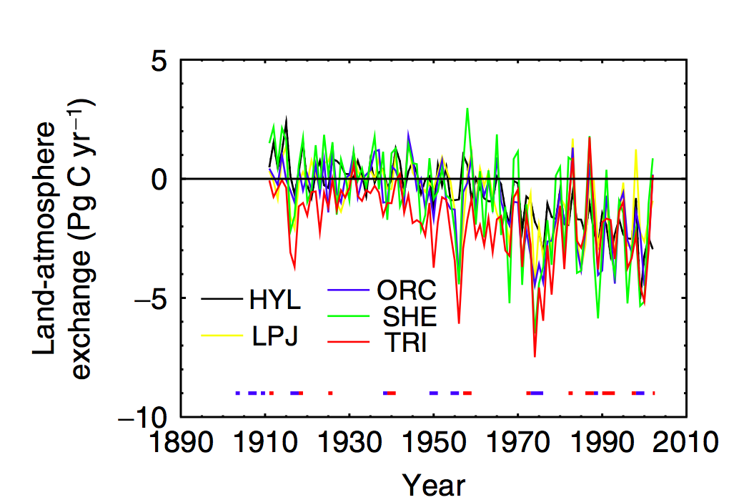
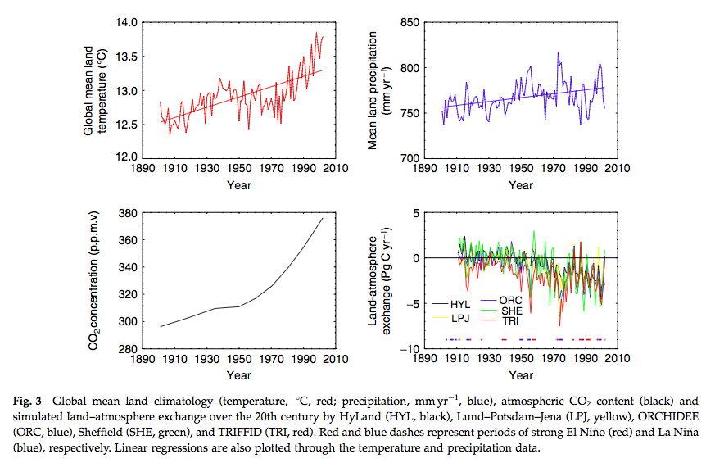
Notes:
But year on year responses quite different between models …We see, for example significant scatter on the year to year responses of the models when considering the land-atmospherie carbon exchange, particularly for ENSO years, although the general trends are similar (hence the level of agreement noted above for decadal or longer integrals).

Slide 40
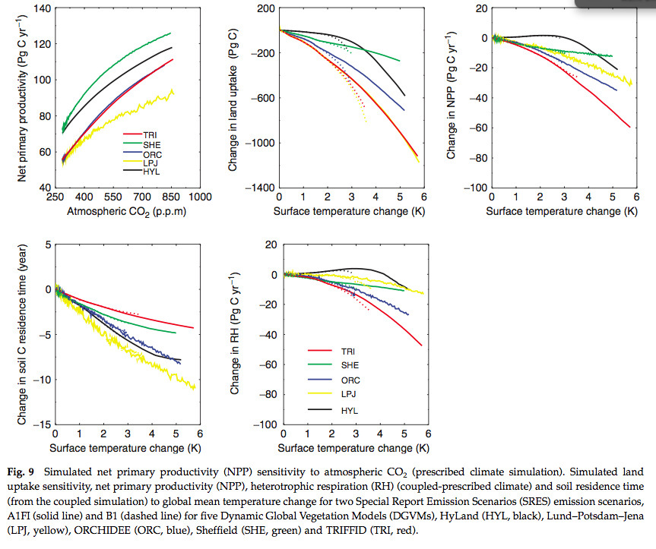

Slide 41
2. Global vegetation modelling
In this section,
noted that the two main types of model we are interested in are DGVMs and PEMs.
Outlined some of the main features of DGVMs and discussed some of the concepts they employ, such as PFTs.
Traits databases
We have also considered how we can tell how good these models are.

Slide 42
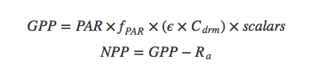
3. Production efficiency models
‘Monteith’ approach
The scalars represent multiplicative environmental constraints that are typically meteorologically derived (i.e. limiting factors).
Notes:
GPP is the Gross Primary Productivity (gCm−2), ϵ is the ‘light use efficiency’ (LUE) (g dry matter per MJ PAR), Cdrm is the carbon content of dry matter (0.45 gCg−1), fPAR is the fraction of PAR absorbed by the canopy (also known as fAPAR), and PAR is Photosynthetically Active Radiation (MJm−2) or the downwelling shortwave radiation multipled by the the PAR fraction of direct and diffuse illumination taken together. NPP is the Net Primary Productivity (gCm−2) and Ra is the autotrophic respiration (gCm−2).

Slide 43
PEMs
Attractions:
simple and
captures the ‘main effect’
C assimilation increases with increasing PAR absorption in the absence of limiting factors
including such limits as scalars
fAPAR is potentially accessible from satellite data, so a major part of the model can be driven by observations globally.

Slide 44
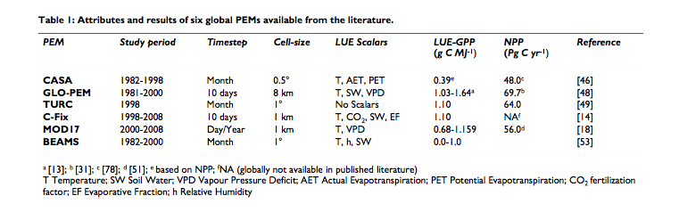
Some PEMs
Notes:
NB read see McCallum et al for review

Slide 45
PEM requirements
LUE often assumed constant
e.g. constant globally in CASA or
per biome via a land cover map as in MOD17.
GLO-PEM does not assume a constant LUE.
make use of satellite data (fAPAR),
But most also require climate data
(for APAR and to drive limiting scalars).
Only GLO-PEM runs on only satellite data (with the exception of attribution of C3 and C4 plants).

Slide 46
Some issues
LUE should not be assumed constant, but should vary by PFTs
Results are strongly dependent on the climate drivers used for particular models (which also complicates intercomparison)
Further use of satellite data would alleviate the need for many or all climate drivers.
PEMs should consider incorporating diffuse radiation, especially at daily resolution
PEMs should also consider the need to account for GPP saturation when radiation is high

Slide 47
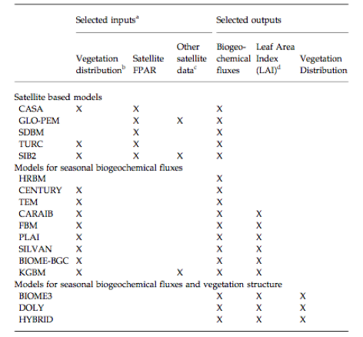
How good are these models?
Cramer et al. (1999) intercomparison
PEMs & other models

Slide 48
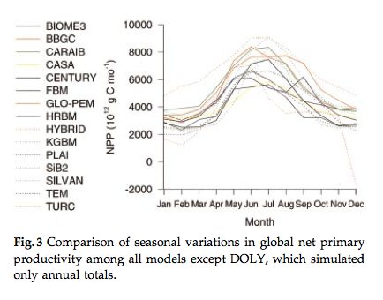
How good are these models?

Slide 49
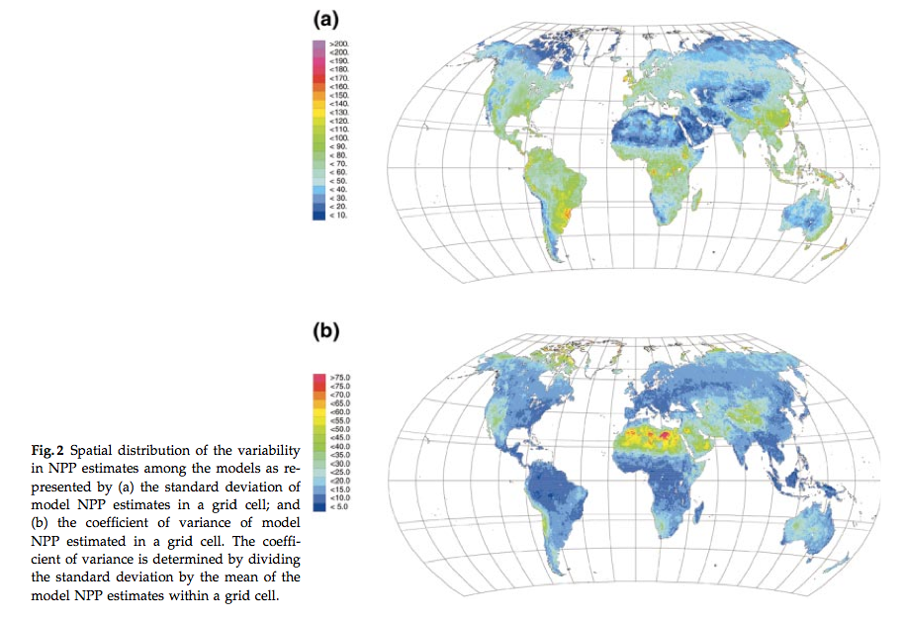
How good are these models?
Notes:
These results are claimed to be ‘relatively good’ considering this is a relatively poorly understood variable,and one thing the study highlights is degree of our current uncertainty of this quantity. Within this range of spread then, the PEMs performed no more poorly than other models and PEMs should be considered a viable semi-independent approach for NPP monitoring.

Slide 50
3. Production efficiency models
Summary
overview of PEM approach.
The key idea that non-limited carbon assimilation can be assumed a linear function of the capacity of a canopy to absorb shortwave (specifically PAR) radiation and the amount of downwelling PAR.
Models particularly useful as they can be largely driven by observations (or rather fAPAR, derived from satellite observations).
Several key issues in the use of such models are highlighted, but these models seem to perform ‘quite well’ in comparison to mechanistic approaches.
Since these models are driven by observations, they cannot directly be used in prognostic mode.

Slide 51
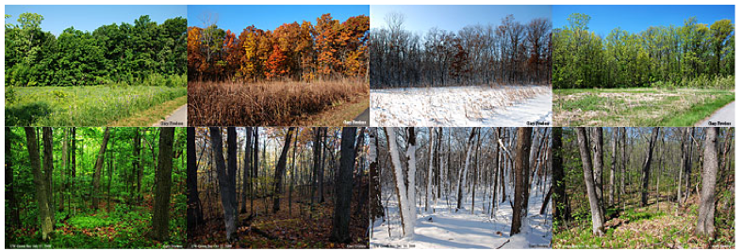
4. Phenology

Slide 52
Phenology
plants experience daily and seasonal variations in environmental conditions.
tend to adjust their behaviour to these variations.
diurnal variations in light, temperature and water.
Many plants then exhibit cirdadian rhythms (24 hour cycles) for example in stomatal opening

Slide 53
Phenology
temperate climate plants: strong seasonal variations in environment
generally exhibit a predictable pattern of phenology
put more resources into leaf production at certain times, flowers at others etc.
E.g. leaf senescence timing from photoperiod
Cues onset of winter
shift resources (nutrients, carbohydrates, water) from leaves to other organs to prevent their loss from the plant
Notes:
Photoperiod: proportion of day to night

Slide 54
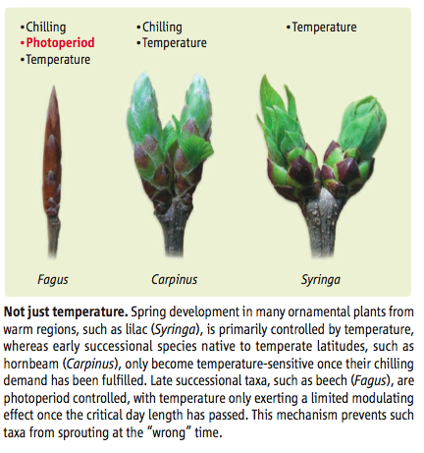
Extratropics (outside tropics)
Photoperiod same in winter and autumn,
plants need a cue that winter is over.
This is often obtained from the dose of low T … a ‘chilling’ requirement by some plants before spring bud burst

Slide 55
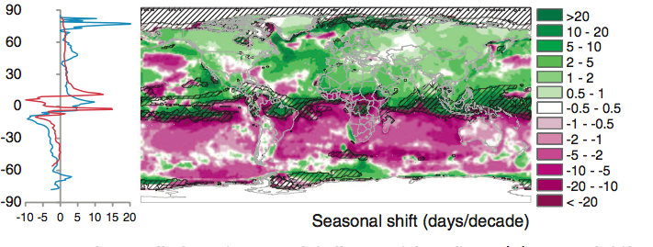
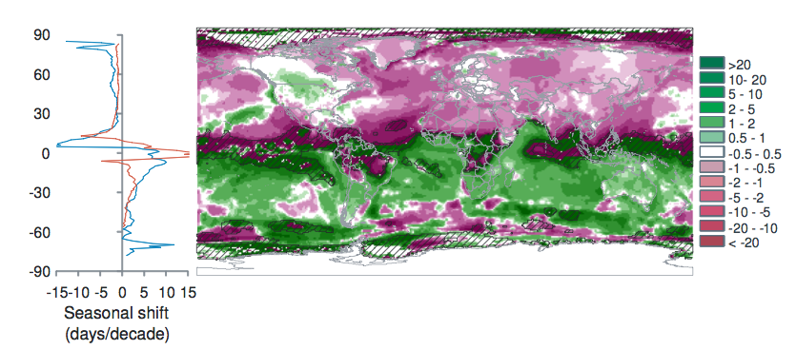
Spring Temp.
Seasonal shift in temp. 1960-2009
AutumnTemp.
Notes:
Burrows et al. 2011 analysed global temperature trends over the period 1960-2009 and have noted the following patterns of advance in Spring temperatures and delay in autumn temperatures.
“Seasonal shift (days/decade) is the change in timing of monthly temperatures, shown for April (top), representing Northern Hemisphere spring and Southern Hemisphere fall and October (bottom): positive where timing advances, negative where timing is delayed. Cross-hatching shows areas with small seasonal temperature change (<0.2 C/month), where seasonal shifts may be large.” Source: Burrows et al. 2011

Slide 56
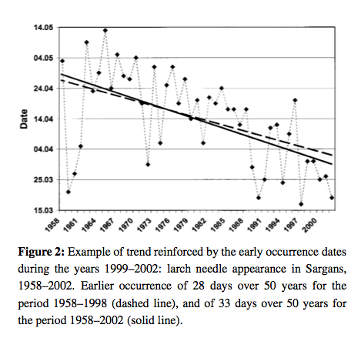
phenology
Notes:
Plant responses to such climatic variables means that phenology is likely to change under climate change, and there is already much evidence for this.
Our evidence for phenological changes comes from a combination of ground observations of this sort, flux towers, and satellite observations.
Until relatively recently there has been little work linking these two sources of information, partly due to a spatial paucity of ground data until recent years and partly because of complexities in matching the scales of the observations (Liang et al., 2011; Studer et al., 2007; White et al., 2009).

Slide 57
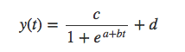
Models of phenology
Simplest: logistic fn of time
e.g. Zhang et al., 2003 MODIS phenology

Slide 58
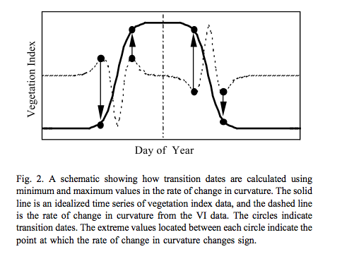
Track features of phenology

Slide 59
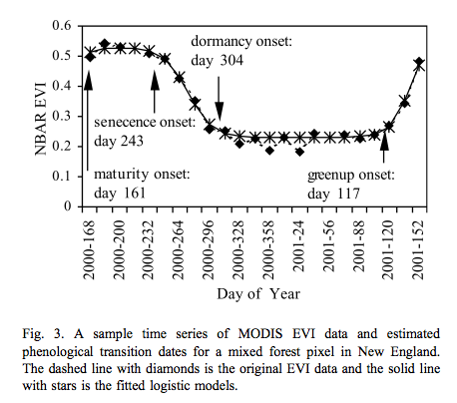
Track features of phenology

Slide 60
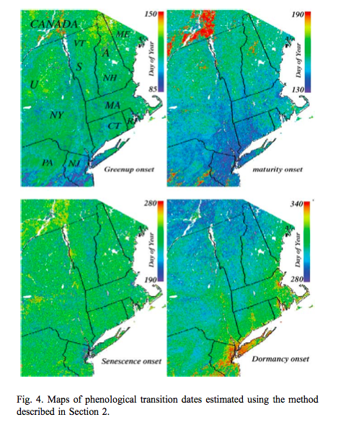
Such processing provides valuable spatial datasets of information related to phenology and allows the tracking of dynamics of the phenology metrics over time.
model of this sort is used to derive data that are then used to model phenology.

Slide 61
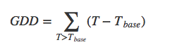
(Growing) Degree day model
simplest form of model that can be used prognostically
only really appropriate where temperature is a limiting factor in plant growth (the extratopics).
identify some threshold value of GDD F∗ that corresponds to the metric of interest.
So essentially 2 parameters (Tbase & F*)

Slide 62
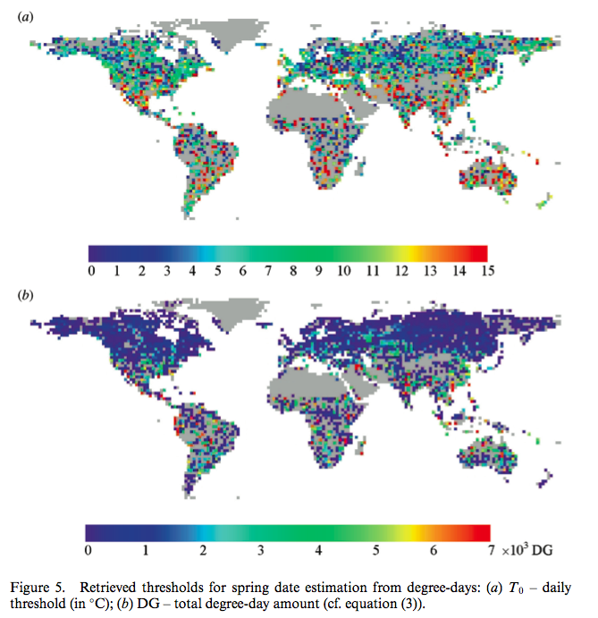
Notes:
e.G sobrino et al 2011 double logistic function of the same form for mapping changes in spring date timing trends for global vegetation from avhrr

Slide 63
Model calibration
Take data (e.g. satellite VI) and T dataset
Extract phenology metric (e.g. bud burst) from VI
Work out which Tbase & F* give best fit to this
Over long time series per location
Or assuming parameters constant spatially

Slide 64
Chilling
Can incorporate chilling:
sequential models:
forcing only starts when the chilling requirement is met
parallel models:
chilling and forcing accumulated in parallel and critical values then applied to both
alternating models:
the temperature F∗ is a decreasing function of chilling.

Slide 65
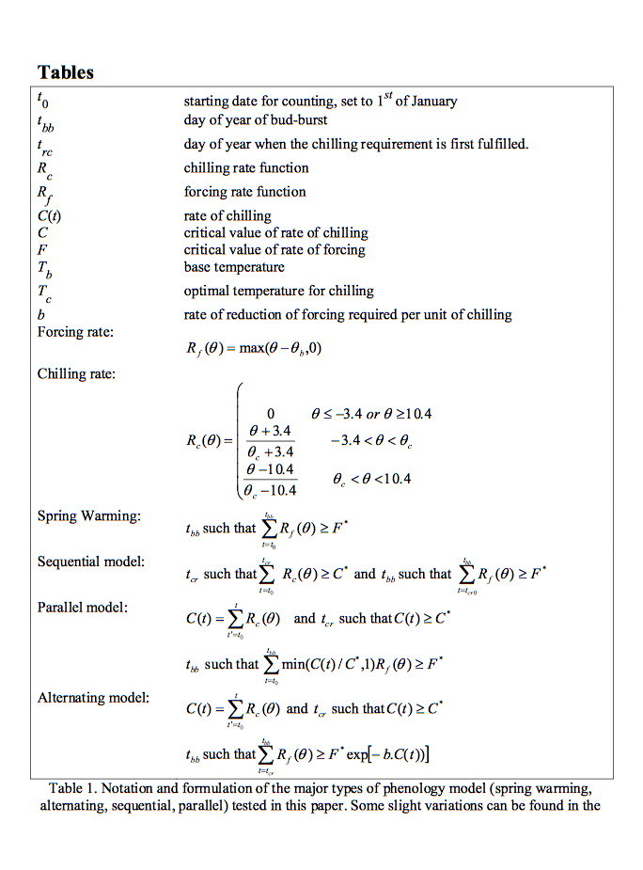
Picard et al. (2005) use NDWI to track chilling for Siberia
Use to calibrate DVGM

Slide 66
tropics
simulating and understanding phenology is complicated
Mainly water constraint
But complicated as not just dept. on precipitation
Plants may have deep or shallow roots
The state of phenology models in DGVMs for tropical areas then is at present rather weak and an area of active research.

Slide 67
4. Phenology
Summary
Phenology important concept in monitoring, modelling and understanding vegetation dynamics and its response to climate variations.
growing amount of observational data on phenology at various scales and more recent attempts to reconcile measures at different scales.
likely that for some areas at least, species specific (or slighly broader groupings of species) parameterisations of phenology need to be considered rather than just broad PFT definitions.
Most phenology analysis is done using simple degree day models, although some analyses also consider chilling requirements.
Phenology models in DGVMs may be phrased rather differently to those used in most analyses. Whilst maintaining a required ‘mechanistic approach’, current DGVM phenology models are not entirely satisfactory.

Slide 68
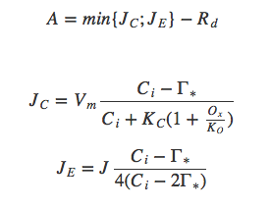
5. Modelling Photosynthesis
Farquhar approach:
Assim. Rate = min of electron transport limited rate and carboxylating rate JE, JC, & leaf dakr resp Rd; Gamma* is CO2 compensation point without leaf resp.
Notes:
In the ‘Farquhar’ approach (Farquhar et al. 1980), the non-limited photosynthetic rate A0 is calculated for a fixed value of intercellular CO2 concentration Ci,0 (Knorr, 1998). The actual carbon assimilation rate A: at the leaf level depends on the actual intercellular CO2 concentration Ci. For the C3 pathway it is calculated as a function of the electron transport limited rate JE and a carboxylating rate JC controlled by the enzyme Rubisco (units mol(CO2)m−2s−1) and the leaf ‘dark’ respiration rate Rd:
Here, Γ∗ (mol(CO2)mol(air)−1) is the CO2 compensation point without leaf respiration, KC is the Michaelis-Menton constant for CO2 (mol(CO2)mol(air)−1), Ox is the oxygen concentration (0.21 mol(O2)mol(air)−1), KO is the Michaelis-Menton constant for O2 (mol(O2)mol(air)−1), and J is the electron transport rate:

Slide 69
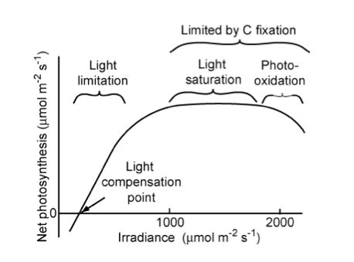
Notes:
“Relationship of net photosynthetic rate to photosynthetically active radiation and the processes that limit photosynthesis at different irradiances. The linear increase in photosynthesis in response to increased light (in the range of light limitation) indicates relatively constant light use efficiency. The light compensation point is the minimum irradiance at which the leaf shows a net gain of carbon.” Source: Chapin, 2011, PTEEChap5.ppt, fig. 5.5

Slide 70
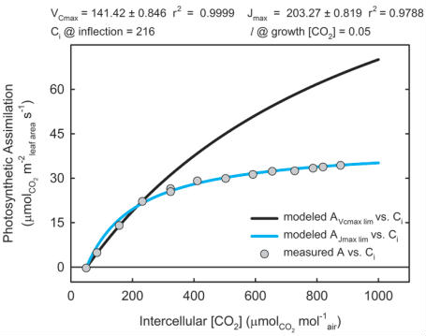
Notes:
“Figure of the photosynthetic response to increasing CO2. Glycine max (soybean) leaf was excised from experimental-garden grown plant and then light acclimated at 1500 Âµmol m-2 s-1 (saturating) in a lab. Experimental data (circles) was modeled using the equations of Farquhar, von Caemmerer and Berry (1980) for maximum velocity of carboxlation (VCmax, black line) and the maximum electron transport rate for RuBP regeneration (Jmax, cyan line). The intercellular CO2 (Ci) at which photosynthesis transitions from VC-limited to J-limited is 216 Âµmol CO2 mol-1 air. Stomatal limitation to photosynthesis (l ) is the effect of the stomata resistance restricting photosynthesis decreasing CO2 available for photosynthesis at growth CO2 concentration.” Source: johnmorris.com

Slide 71
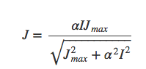
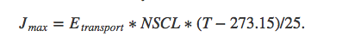
Electron transport rate
depends on I, alpha, Jmax
I=IPAR/EPAR where IPAR (Wm−2) is the PAR absorption rate EPAR the energy content of PAR quanta (220 kJmol−1), Jmax the maximum electron transport rate, (mol(CO2)m−2s−1 and α the efficiency of photon capture (0.28).
NSCL is a Nitrogen scaling factor at maximum carboxylation rate and maximum electron transport rate.
Notes:
I=IPAR/EPAR where IPAR (Wm−2) is the PAR absorption rate EPAR the energy content of PAR quanta (220 kJmol−1), Jmax the maximum electron transport rate, (mol(CO2)m−2s−1 and α the efficiency of photon captupre (0.28).
NSCL is a Nitrogen scaling factor at maximum carboxylation rate and maximum electron transport rate.

Slide 72
Exploring Farquhar’s Eqn
An IPython notebook you can use to familiarise yourself with the Farquhar Photosynthesis model:
http://bit.ly/1eAm2xz

Slide 73
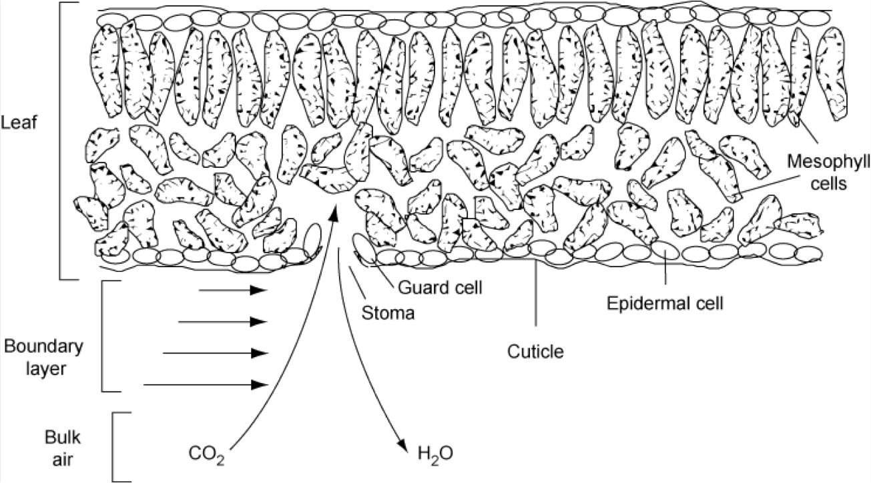
Stomatal conductance
when plants decrease stomatal conductance (increase resistance) to minimise water loss, photosynthesis declines redcuing the efficiency at which plants convert light to carbohydrates

Slide 74
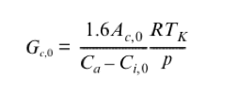
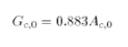
Model of stomatal conductance
Non water stressed:
Often strong relationship between Gc,0 and assimilation:
Notes:
which is considered a function of leaf temperature (Tk, K), non-water-limited net leaf CO2 uptake rate(Ac0, umol m-2 s-1), Ca the atmospheric CO2 concentration (355 umol(CO2)/mol(air)) and standard non-stressed leaf- internal CO2 concentration, (Ci,0). R is the gas constant (8.3145 J/mol K, so units: kg m-2 s-2 mol-1 K-1), and p is the air pressure of the standard atmosphere (Pa, i.e. kg m-1 s-2), so that Gc0 is given in m/s (Knorr, 2000). The factor of 1.6 accounts for the different molecular diffusivities of water and carbon dioxide.

Slide 75
5. Modelling Photosynthesis
Summary
outlined the ‘Farquhar’ approach to modelling photosynthesis, that is used in this or related forms in most DGVMs.
Relates carbon assimilation rate to the minimum of two potentially limiting factors
the electron transport limiting rate and
a carboxylating rate,
with leaf ‘dark’ respiration subtracted.
it relates carbon assimilation to ambient CO2 concentrations.
outlined some concepts about what controls stomatal conductance.
important concept because it can limit carbon assimilation and relates to water use by the leaf (transpiration).

Slide 76
Summary
more detail considering processes in vegetation canopies (and their interface to the atmosphere and soils).
outlined land surface schemes and models as the ‘containers’ (in e.g. an Earth system model) for models of vegetation process.
considered carefully energy and water balances.
outlined some basic concepts in vegetation growth, and reviewed the development of current LSMs, highlighting the inclusion of carbon fluxes in the current generation.
reviewed the structure of DGVMs, and considered in detail PFTs and parameterisation of DGVMs, highlighting trait databases as a useful source of information on this .
looked into how well we can tell DGVMs are operating, concluding that the current generation show a significant amount of scatter, but they agree broadly in some key areas.

Slide 77
Summary
PEMs as a viable (more data-driven) approach to modelling NPP.
We saw that again there is a lot of scatter in NPP estimates, but those produced by the PEMs are broadly in agreement with those from the DGVMs and other more mechanistic approaches.
phenology in some detail, highlighting the mechanisms and modelling approaches.
some of the basic equations for photosynthesis and stomatal conductance as used in most DGVMs

Slide 78
Recommended Reading
Box., E.O. 1996, Plant Functional Types and Climate at the Global Scale, Journal of Vegetation Science, Vol. 7, No. 3 (Jun., 1996), pp. 309-320
D. B. Clark, et al. (2011) The Joint UK Land Environment Simulator (JULES), model description: Part 2: Carbon fluxes and vegetation dynamics, Geosci. Model Dev., 4, 701-722, 2011, doi:10.5194/gmd-4-701-2011
Cramer W, Kicklighter DW, Bondeau A, Moore Iii B, Churkina G, Nemry B, Ruimy A, Schloss AL: Comparing global models of terrestrial net primary productivity (NPP): Overview and key results. Global Change Biology 1999, 5:1-15.
Chapin, F.S, Matson, P.A., and Mooney, H.A., (2002) Principles of Terrestrial Ecosystem Ecology, Springer: Chapters 5 and 6 .
Kattge, J., et al. (2011), TRY: a global database of plant traits. Global Change Biology, 17: 2905-2935. doi: 10.1111/j.1365-2486.2011.02451.x
Knorr, W. (2000) Annual and interannual CO exchanges of the terrestrial biosphere: process-based simulations and uncertainties, Global Ecology & Biogeography (2000) 9, 225-252
Korner and Basler, 2010, Phenology Under Global Warming, Science 19 March 2010: 1461-1462.DOI:10.1126/science.1186473
McCallum, I., et al., 2009, Satellite-based terrestrial production efficiency modeling, Carbon Balance and managementi, 4:8 doi:10.1186/1750-0680-4-8

Slide 79
Recommended Reading
Peng, C. (2000) From static biogeographical model to dynamic global vegetation model: a global perspective on modelling vegetation dynamicsi, Ecological Modelling, Volume 135, Issue 1, 25 November 2000, Pages 33-54
Pitman, A.J, (2003) THE EVOLUTION OF, AND REVOLUTION IN, LAND SURFACE SCHEMES DESIGNED FOR CLIMATE MODELS, Int. J. Climatol. 23: 479-510 (2003)
Prentice et al. The Carbon Cycle and Atmospheric Carbon Dioxide, 2001, IPCC AR3 WG1
Randerson, et al. 2009. Systematic Assessment of Terrestrial Biogeochemistry in Coupled Climate-Carbon Models. Global Change Biology, 15(9):2462-2484.
Sellers PJ, et al. 1992b. Canopy reflectance, photosynthesis and transpiration. III. A reanalysis using improved leaf models and a new canopy integration scheme. Remote Sensing of the Environment 42: 187-216.
Sitch S, et al.(2008) Evaluation of the terrestrial carbon cycle, future plant geography and climate-carbon cycle feedbacks using 5 Dynamic Global Vegetation Models (DGVMs). Global Change Biology 14:2015-2039
Woodward, F.I. Lomas, M.R. (2004) Vegetation dynamics - simulating responses to climatic change, Biol. Rev. 79, 643-670
Zhang, X. Y., Friedl, M. A., Schaaf, C. B., Strahler, A. H., Hodges, J. C. F., Gao, F., et al. (2003). Monitoring vegetation phenology using MODIS. Remote Sensing of Environment, 84, 471-475.

